Slide 1
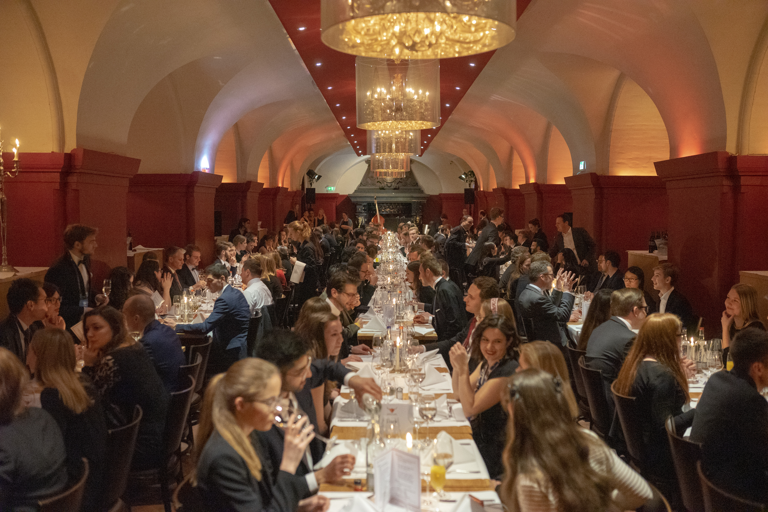
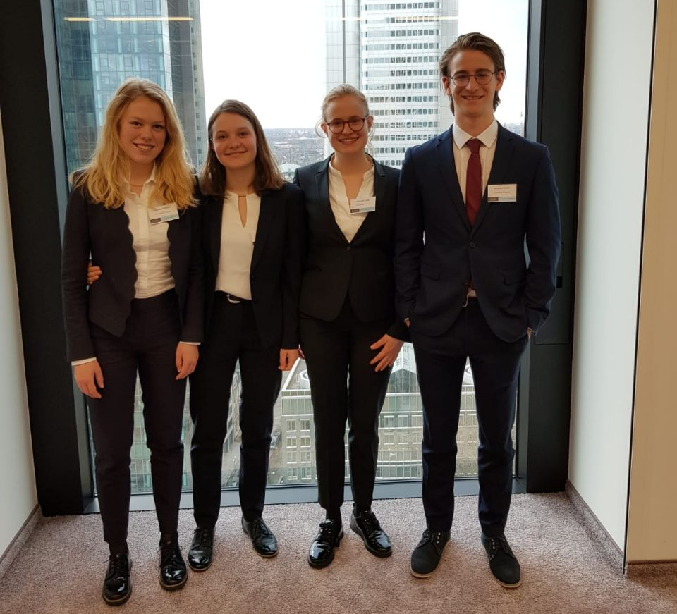
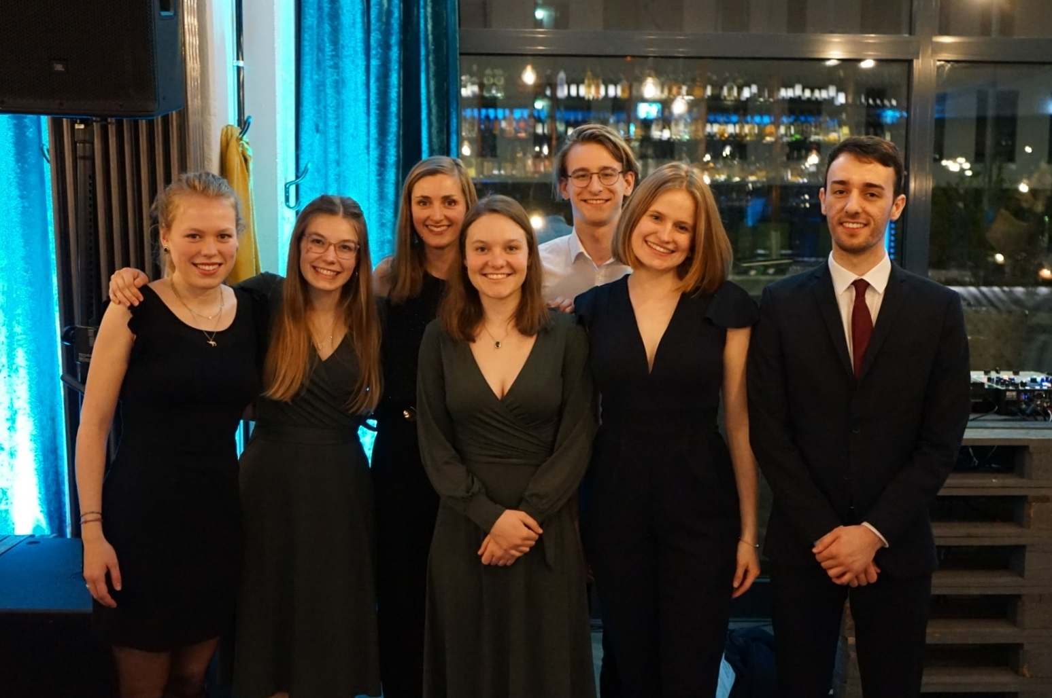
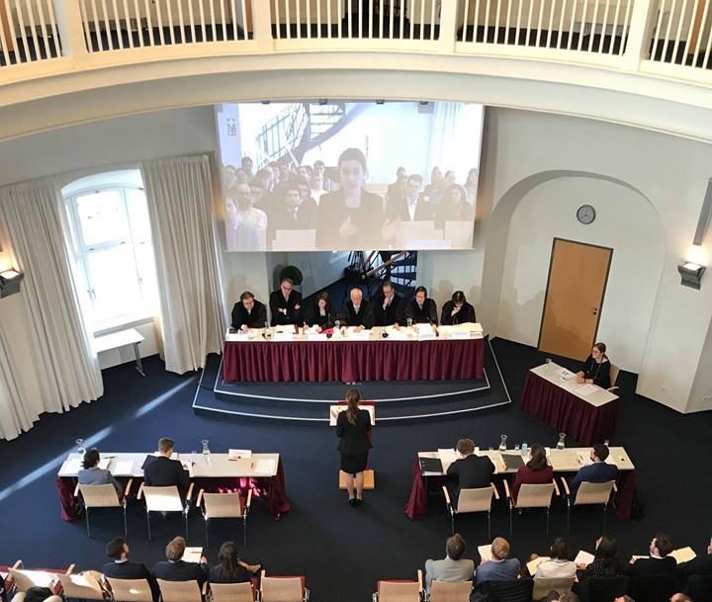
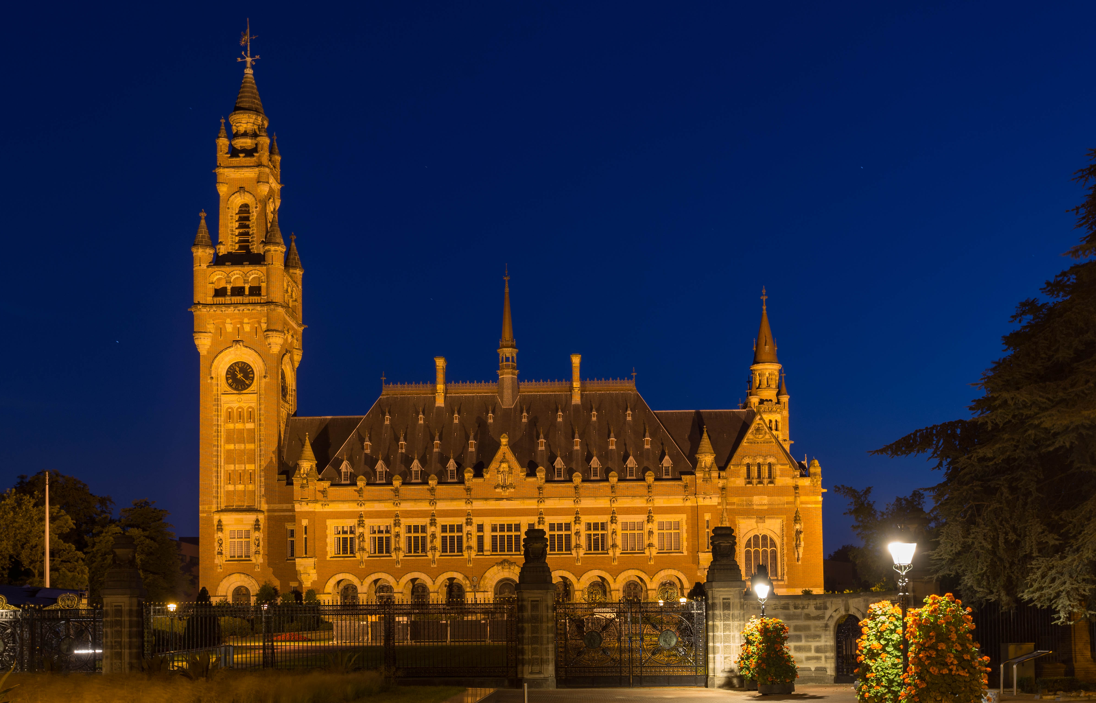


Join the Jessup!
Deal with the responsibility of States with respect to the outbreak of a global pandemic!
Represent a State before the International Court of Justice!
Present your arguments in front of judges of the ICJ, ECtHR, the German Constitutional Court and at international law firms.
Improve your legal English, your rhetorical skills and your knowledge of public international law!
Take your chance to compete against universities from all over the world in Washington, D.C.!
Deadline for applications
June, 9th at midnight
For more information visit
www.jessup.uni-freiburg.de
jessup.uni.freiburg
If you have any questions, don‘t hesitate to contact Elisabeth Andersen (jessup@jura.uni-freiburg.de)!

